Slide 1

CSC 414 Software Design Project
By Ian Hurley

Slide 2

What is the Software
The program is a simple menu-based calculator
Does simple calculations, trigonometry functions, and more complex calculations
Exponents
Hypotenuses
Circumference

Slide 3
Software Design
Program split into three file groups
A group being defined as the header and its corresponding .cpp file
First file is the main
Only used as start for program and dives into other functions
Second file group is the menu
Is where the user will interact with the program
User picks what function they want and give their input

Slide 4

Software Design Cont.
Third file group is the calculator
Where all math functions are contained
Prints answer in format that shows how the equation was done

Slide 5
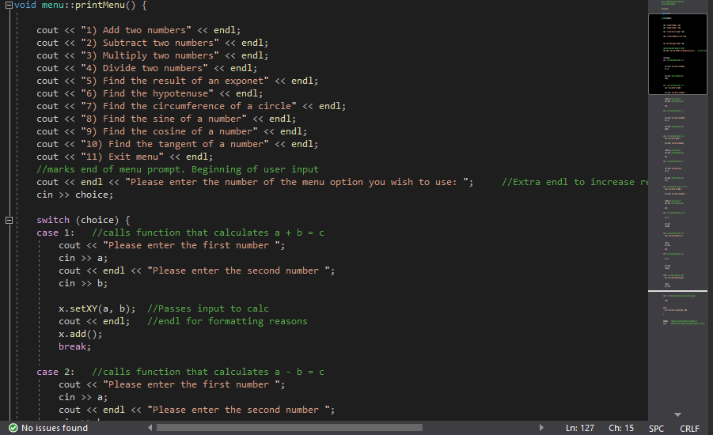
How is the Menu class designed?
Uses 3 variables
One is to hold which menu option is used
Other two hold input to pass into math functions
Is made up of one function
Prints options to screen then asks for input
Menu choice handled via switch statement
Inside menu option input for problem is asked
Done in menu instead of calc for question specific lines
Keeps user strictly to menu class

Slide 6
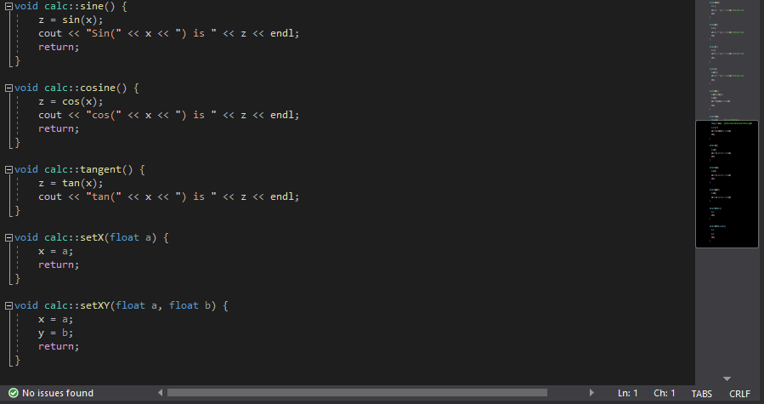
How is the Calc class designed?
Three variables are utilized
Two hold the user input from menu
Last one holds the answer
Each function is set up in similar way for consistency
First the calculation is done
Then the answer is printed to screen in an 'a + b = c` format
Only exception is the setter classes
One is for `a` by itself
Other for 'a' and 'b'

Slide 7
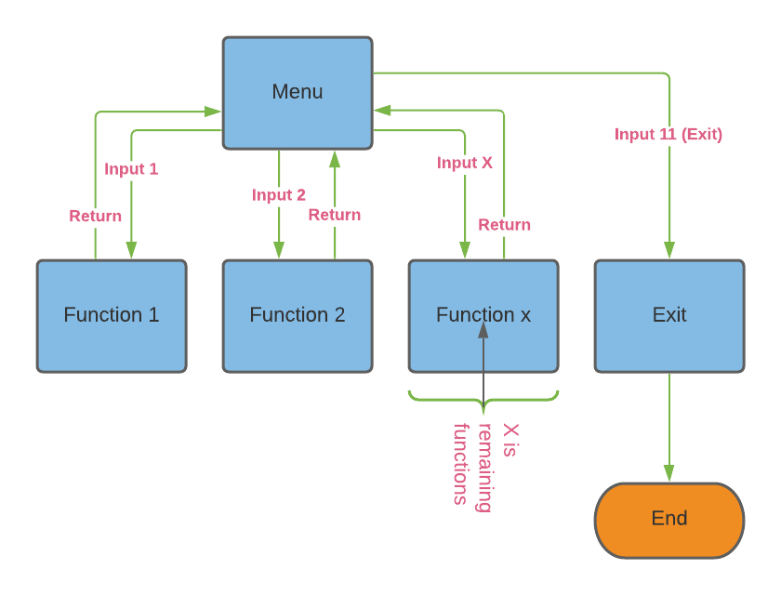
State Diagram

